Slide 1



The Quest for Mjolnir
Finding Thor’s hammer through the power of data analysis

Slide 2

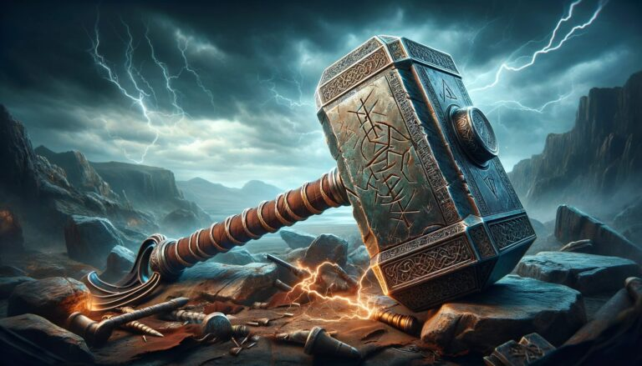
Introduction and assumptions
Project Prompt: Mjolnir (Thor’s Hammer) fell on earth and was “covered up” as a normal meteorite landing. Since Thor is the god of thunder, his hammer’s arrival would be accompanied by thunderstorms.
Goal: Find weather stations in range of meteorite landings and determine if there were more thunderstorms than normal around the time when the meteorite landed.
Selection Criteria 1: There are 10 or more thunderstorms above the 10 year average in the year the meteorite landed
Selection Criteria 2: The number of thunderstorms in the year the meteorite landed is over 50% more than the 10 year average
The following two datasets were used:
National Centers for Environmental Information Global Surface Summary of Day Data (GSOD)
NASA comprehensive data set of Meteorite Landings from The Meteorological Society

Slide 3
Data analysis flowchart
Scrape raw weather data from online databases
Initial analysis of weather station data to find thunderstorm statistics
Analysis of meteorite data to match with local weather stations and filter with selection criteria
Create charts and graphs
download_data.py
unzip_data.py
Thunder_data_per_station.ipynb
currently being converted:
thunder_counts.py
thunder_averages.py
Mjolnir.ipynb
Meteorite_Plots.ipynb

Slide 4
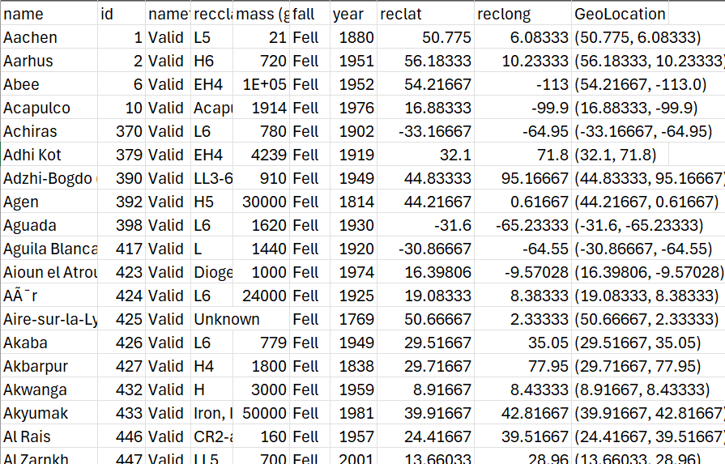
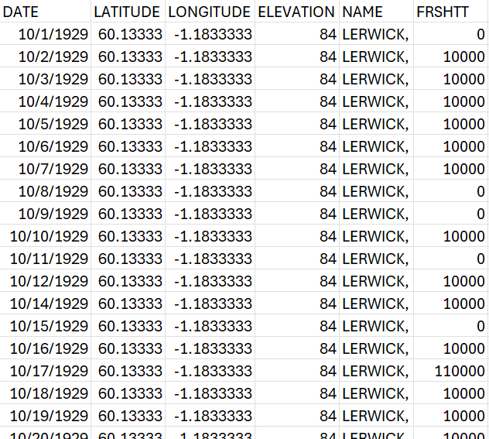
Data structures
Meteorite Data
Weather Station Data

Slide 5
Thunderstorm Analysis of Weather Stations
Each weather station reports a variety of meteorological data in the database, but we are interested only in one data point
FRSHTT stands for “Fog, Rain, Snow, Hail, Thunder, Tornado”, where each digit in the integer corresponding to a Boolean “1” or “0” for appearance that day
We look at the tens place of this integer to identify if thunderstorms happened that day
Across a year of data, this becomes a total occurrences of thunderstorms that year, which can be averaged across a 10 year timeframe to find outliers in yearly thunderstorm occurrence

Slide 6
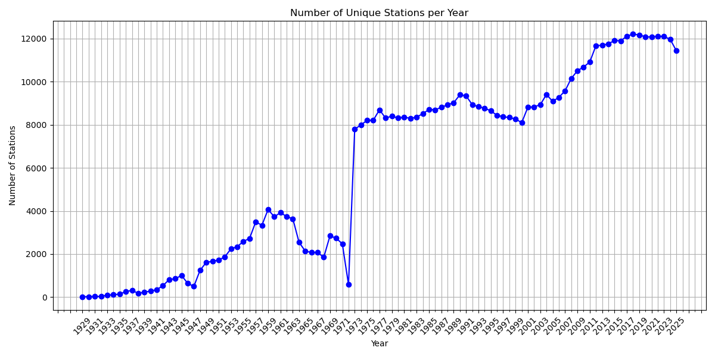
Number of weather stations per year
The total number of weather stations and complete weather data becomes much more complete around 1973

Slide 7
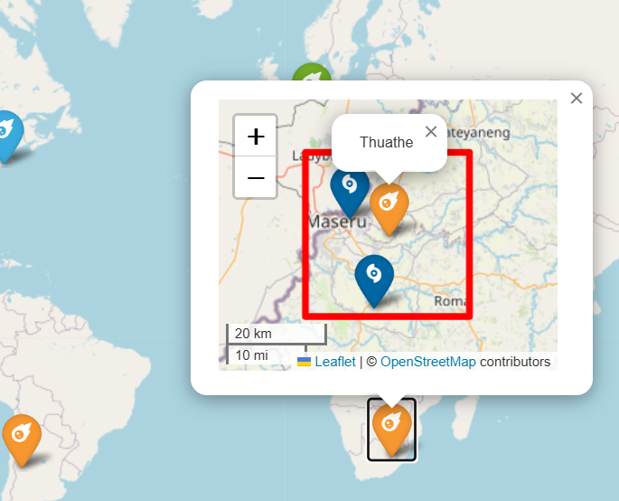
Weather Station Selection Criteria
Thunder has a range of around 10 miles (https://www.noaa.gov/jetstream/lightning/sound-of-thunder)
A bounding box of 10 miles is created around each meteorite landing based on the Haversine Algorithm.
The number of thunderstorms for the meteorite landing is a Union of the thunderstorm data for all stations in range.
A more stringent approach would use the Intersection of the thunderstorm data. This may become a future change to the analysis method.
Example of the “Thuathe” meteorite bounding box with two stations in range

Slide 8
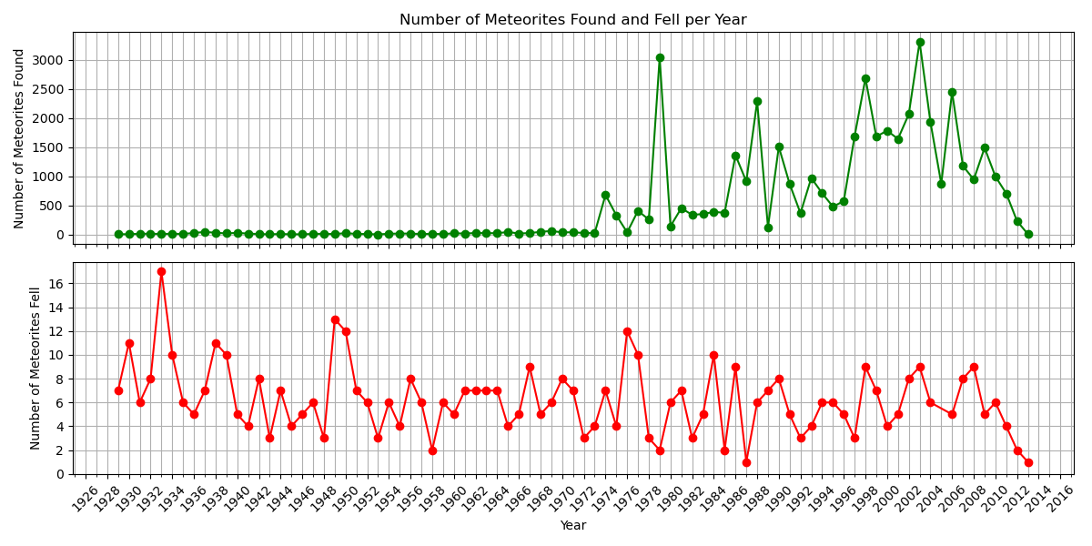
Found vs Fell meteorites
Fell Meteorites are those meteorites have been observed to have fallen.
Meteorite rock associated with the witnessed fall event has been found
Can be associated with a specific date when the fall occurred
Found Meteorites are those that have been identified as extraterrestrial rock but are not associated with a known fall event.
Many more finds than falls exist in the database, but falls are much more useful with respect to this analysis.
https://www.lpi.usra.edu/meteor/docs/falls-finds.pdf

Slide 9
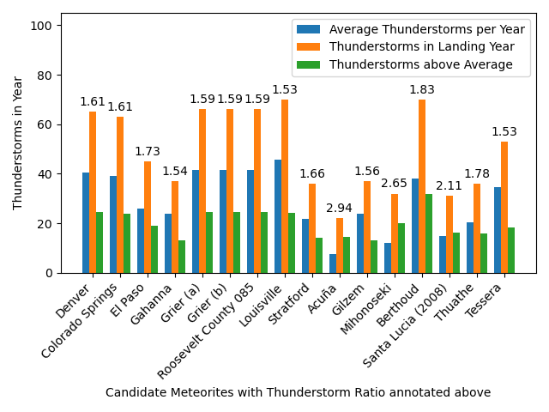
16 Prime Mjolnir Candidates Found

Slide 10
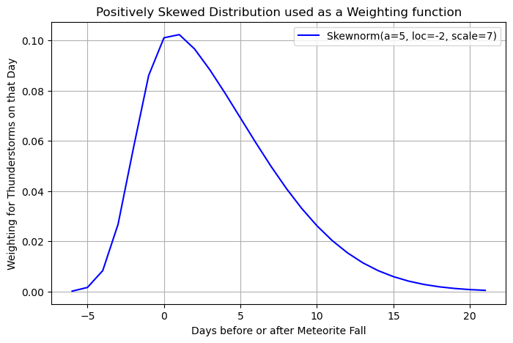
Conclusions and the Future
16 Meteorites which met the 2 Criteria were identified from the database.
The next step is to compare the meteorites by investigating thunderstorm occurrences in the days surrounding the fall, and not just the overall yearly averages.
A weighting function will be used to prioritize thunderstorms closer to the landing date, creating an ordered list of the candidates.

